Slide 1

Bi hotel &
resort
Booking Cancellation:
A bigger problem that you thought
CLIENT RELATIONSHIP MANAGEMENT DEPARTMENT

Slide 2
Table of contents
1
About the Company
3
Insights & Actions
2
About the analysis
4
Risks & limitations
5
Next step
6
Interesting findings
2

Slide 3

1
About the
company
3

Slide 4

About
us
We are an esteemed hotel group specializing in city hotels and resorts in Portugal.
At our hotel group, we are dedicated to providing exceptional guest experiences that embody the essence of Portuguese hospitality.
4

Slide 5
existing situation (2015-17)
Cancellation rate
Cancellation by Country
37%
€ 102
3 Days
100 days
Average per night
Average stay
Average lead time*
* Lead time refers to the number of days between booking date and arrival date
5

Slide 6
The problem: Booking Cancellation & the impact
Vacancy rate
Cancellation
€ 2.1M*
Revenue loss from room cancellation per year
77,100
Total no. of days per room cancelled per year
Affect the hotel’s planning
High cancellation rate harm hotel’s revenue
67%
Not require deposit / Refundable
6
* Assume 40% of the rooms cancelled became loss, representing ~15% of hotel room’s revenue

Slide 7
2
About the
analysis
7

Slide 8
Analysis: cause of booking cancellation
Utilized data from
119,000 customers
between 2015 and 2017 (pre-COVID) to analyze cancellation reasons
Ultimate goal
create an evaluation mechanism
Reducing the Number of Booking Cancellations and Minimizing the Associated Losses and Negative Impact
proactively identify potential booking cancellations
implement preventive/
corrective actions.
8

Slide 9
methodology
Data Cleansing
Develop ML Models
evaluate performance
Checking duplicate data
Logistic Regression
Decision Tree
Compare ROC
Identifying outliers
Compare Recall
Random Forest
Gradient Boosting
Checking missing data
Features Engineering
9

Slide 10
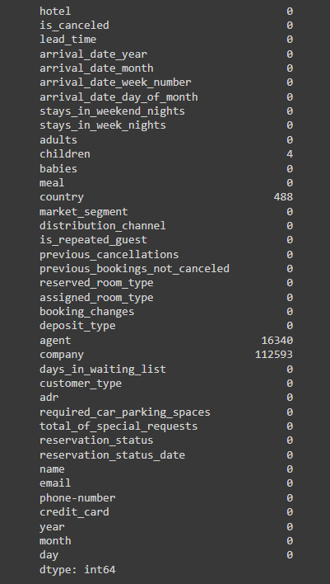
Dealing with missing values
Data Cleansing
  Eliminate records with adults, children and babies all showing zero
  Fill the blanks
    Change “Country” from blank to “unknown”
    Change “Meal” from blank to "SC"
  Eliminated irrelevant variables
    Agent ID – irrelevant to running the model
    Company – already covered corporate or non-corporate booking in "distribution_channel"
10

Slide 11
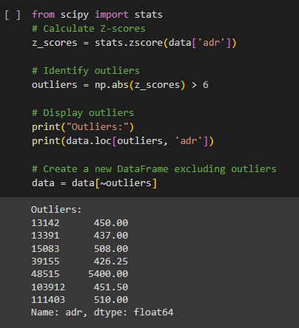
Dealing with OUTLIERS
Data Cleansing
  Identify outliers
  Evaluate whether the outliers exist with a reason
  If not, exclude them from the analysis
11

Slide 12
Feature engineering
Data Cleansing
Create a new feature "stays_in_total_duration“
to capture the total duration of the customer's reservation in days
Encode categorical variables 'hotel', 'arrival_date_month', 'meal', 'market_segment', 'distribution_channel', 'reserved_room_type', 'deposit_type', 'customer_type’
Normalize the continuous variables
12

Slide 13


Develop ML Models
Logistic Regression
Decision Tree
Random Forest
Gradient Boosting
Develop 4 different ML models and compare their performance
13

Slide 14
Logistic regression model
i
ii
Without regularization
LASSO
iii
LASSO with the most optimal
penalty hyper-parameter
iv
Use GridSearchCV to compare the ML model performance using different hyper-parameter "C"
Choose top 15 significant input variables using RFE
14

Slide 15
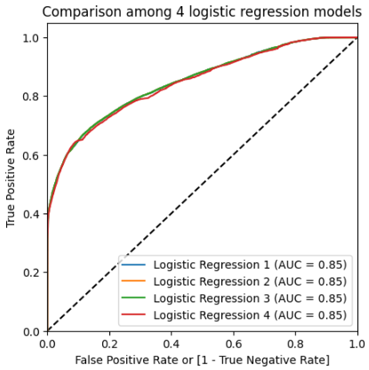
Compare THE 4 MODELS
i
ii
Without regularization
BEST MODEL
the simplest one but with the same explanatory power, say, a "Parsimonious Model".
LASSO
iii
LASSO with the most optimal
penalty hyper-parameter
iv
Use GridSearchCV to compare the ML model performance using different hyper-parameter "C"
Choose top 15 significant input variables using RFE
15

Slide 16
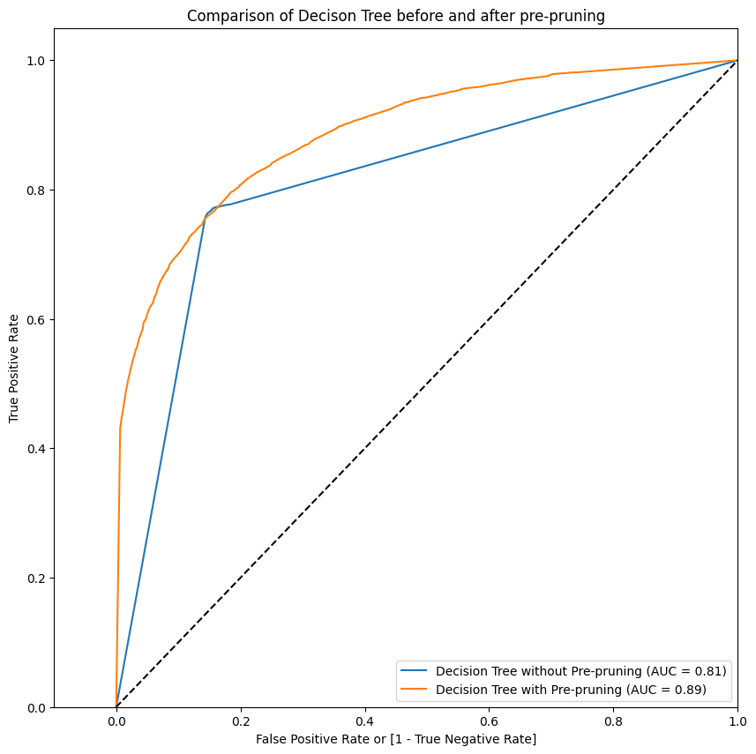
DECISION TREE
i
Without Pre-pruning
Precision on train is: 0.99398730313759
Precision on test is: 0.7494617868675996
Recall on train is: 0.9801071385578428
Recall on test is: 0.7617614879649891
Accuracy on train is: 0.9904028992639986
Accuracy on test is: 0.8185966913861951
Pre-Pruning to solve overfitting issues
With Pre-pruning
Precision on train is: 0.8645309581956615
Precision on test is: 0.817257785467128
Recall on train is: 0.7244492596605273
Recall on test is: 0.6890955506929248
Accuracy on train is: 0.8553947338985705
Accuracy on test is: 0.8288648031945237
ii
16

Slide 17
Random forest
Use GridSearchCV to find the optimal hyper-parameter
Fitting 3 folds for each of 8 candidates, totaling 24 fits
n_estimator: 100
min_samples_split: 50
max_depth: 20
17

Slide 18
Gradient boosting
Use GridSearchCV to find the optimal hyper-parameter
Fitting 3 folds for each of 8 candidates, totaling 24 fits
Learning rate = 1.0
max_depth = 3
n_estimators = 200
18

Slide 19
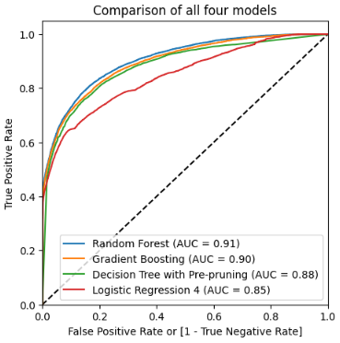
Model comparison: roc
0.85
0.88
0.91
0.90
Logistic Regression
Decision Tree
Random Forest
Gradient Boosting
19

Slide 20


Model comparison
Recall (Random Forest): 0.6581840084324649
Recall (Gradient Boosting): 0.6956783616925162
Recall (Decision Tree with Pre-pruning): 0.6979394602479941
Recall (Logistic Regression 4): 0.5978465476997215
False
Negative
False
Positive
VS
Customer predicted as
“NOT likely to cancel booking”
but actually cancelled booking
Customer predicted as
“likely to cancel booking”
but actually showing up
“recall”
20

Slide 21
Model comparison: recall
0.598
0.689
0.658
0.696
Logistic Regression
Decision Tree
Random Forest
Gradient Boosting
21

Slide 22
3
Insights &
actions
22

Slide 23
Actions to take
Deploy ml model to predict cancellation
Identify key factors causing cancellation
Everytime a new booking is received, input the booking details into the ML model to predict the likelihood of cancellation
Find out the common factors that the customers who cancel booking have
Take precautionary measures
23

Slide 24
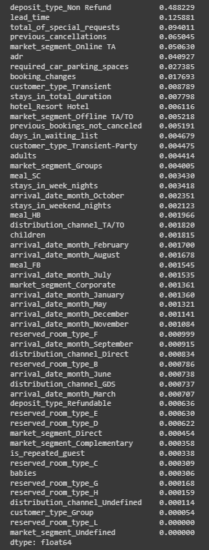
Model to deploy: gradient boosting
Result of Gradient Boosting model
Key insights
  Gradient Boosting shows the ranking of each variables’ importance in predicting the likelihood of booking cancellation.
  Key factors causing cancellations include:
Refundable/
non-refundable deposits
Booking lead time
No. of special requests
Previous cancellation record
Market Segment – Online Travel Agency
Average Daily Rate
24

Slide 25
Major findings on cancellations
Key insights
Other factors
↑ Cancellation rate:
↑ Lead time
↑ Average daily rate
67%
87%
76%
Does not require deposit
Previously not cancelled
Does not make special request
25

Slide 26
Recommendation
Target Audience: Potential customer that has high risk of cancellation
Extra loyalty award for non-cancellation, e.g. free breakfast / dining coupons
Send out reminders to confirm hotel booking
Require booking deposit
Non-refundable cancellation when the lead time is beyond 20 days*
Incentivise
Penalise
26
* Based on the result in decision tree, there is a significant increase in likelihood of cancellations when lead time is above 16.5

Slide 27
4
Risks &
Limitations
27

Slide 28



Risks and Restrictions of the model
temporal dependencies consideration
imbalanced data
managerial decision
  Excluded factors, e.g. seasonality, local events, economic / policy changes
  Biased tree construction
  (67% of dataset are from local visitors)
  Potentially ineffective strategies
28

Slide 29
5
next
Step
29

Slide 30




Model Measures
Identify New Insight
Test the Model on Half Yearly basis
Potential Adjustments to the New Model
  Get additional data for modelling, such as reasons for cancellation
  Third-party data – Economies Index, cultural Habit
  Adjust the model to adapt the new insight
  A sufficient long timeframe to represent any changes of data pattern
  Regularly measure the model’s stability and consistency
  Monitor and explore alternative models
  Adjust the approach if a different model shows superior performance
1
2
3
30

Slide 31
Business Measures
Set KPI and evaluate ML model performance
good
Enhance the measures
Cancellation rate ↓ ?
Benefit > cost ?
bad
Refine measures or ML Model
Customer Satisfaction ↑ ?
Evaluate every 3 months
31

Slide 32
6
interesting
findings
32

Slide 33


Interesting things
How many babies can a family had?
10
How high can a room price surge?
€5,400
Can R² be negative?
Yes !
33

Slide 34
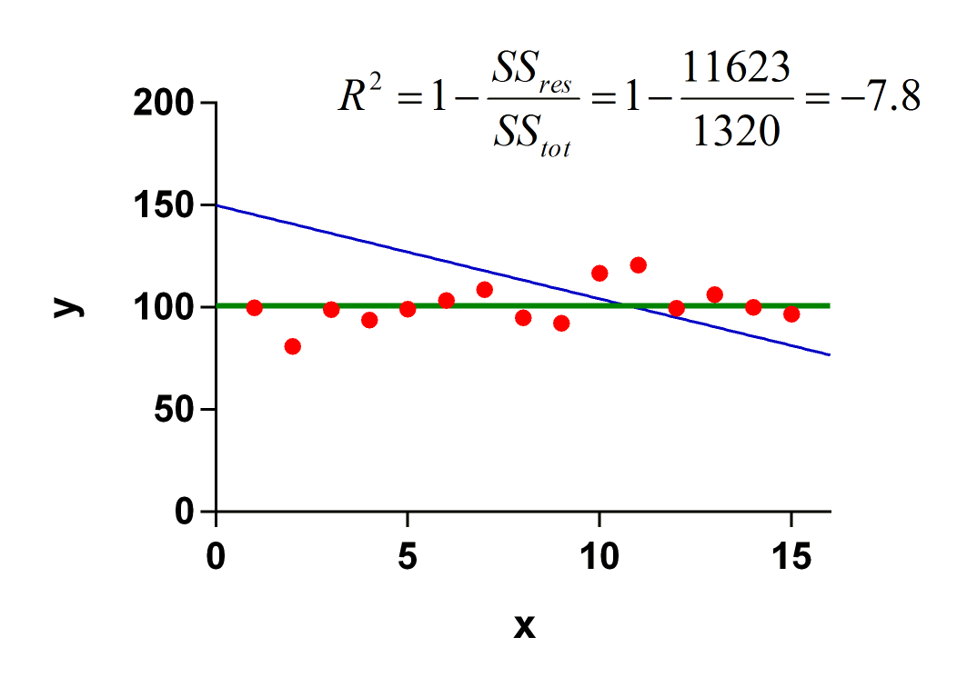
Why R² go negative ?
SS_{tot} (Denominator) is the variation between actual values and the mean.
SS_{res} (Nominator) is the variation between actual values and predicted value by model.
If SS_{res} > SS_{tot}(i.e explanatory power of model < mean), R² will go negative.
It is possible as we build the model on train data and evaluate it on test data!
34

Slide 35

Thank
you

